Slide 1

Inferences Based on Two Samples
Copyright © Cengage Learning. All rights reserved.

Slide 2
z Tests and Confidence Intervals for a Difference Between Two Population Means
Copyright © Cengage Learning. All rights reserved.

Slide 3
z Tests and Confidence Intervals for a Difference Between Two Population Means
The inferences discussed in this section concern a difference μ₁ – μ₂ between the means of two different population distributions.
An investigator might, for example, wish to test hypotheses about the difference between true average breaking strengths of two different types of corrugated fiberboard.

Slide 4
z Tests and Confidence Intervals for a Difference Between Two Population Means
One such hypothesis would state that μ₁ – μ₂ = 0 that is, that μ₁ = μ₂.
Alternatively, it may be appropriate to estimate μ₁ – μ₂ by computing a 95% CI.
Such inferences necessitate obtaining a sample of strength observations for each type of fiberboard.

Slide 5
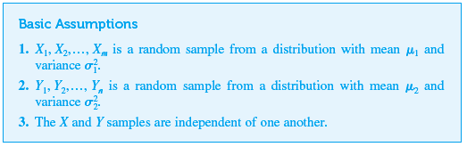
z Tests and Confidence Intervals for a Difference Between Two Population Means

Slide 6
z Tests and Confidence Intervals for a Difference Between Two Population Means
The use of m for the number of observations in the first sample and n for the number of observations in the second sample allows for the two sample sizes to be different.
Sometimes this is because it is more difficult or expensive to sample one population than another.
In other situations, equal sample sizes may initially be specified, but for reasons beyond the scope of the experiment, the actual sample sizes may differ.

Slide 7
z Tests and Confidence Intervals for a Difference Between Two Population Means
For example, the abstract of the article “A Randomized Controlled Trial Assessing the Effectiveness of Professional Oral Care by Dental Hygienists” (Intl. J. of Dental Hygiene, 2008: 63–67) states that “Forty patients were randomly assigned to either the POC group (m = 20) or the control group (n = 20).
One patient in the POC group and three in the control group dropped out because of exacerbation of underlying disease or death.”

Slide 8
z Tests and Confidence Intervals for a Difference Between Two Population Means
The data analysis was then based on (m = 19) and (n = 16) .
The natural estimator of μ₁ – μ₂ is X – Y , the difference between the corresponding sample means.
Inferential procedures are based on standardizing this estimator, so we need expressions for the expected value and standard deviation of X – Y.

Slide 9
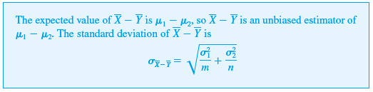
z Tests and Confidence Intervals for a Difference Between Two Population Means
Proposition

Slide 10

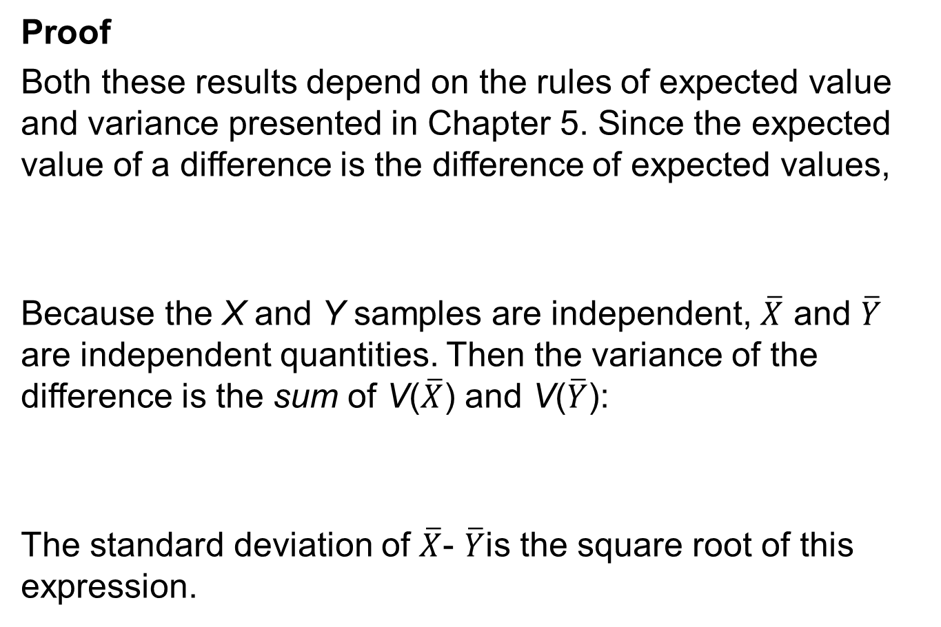
z Tests and Confidence Intervals for a Difference Between Two Population Means
Proof
Both these results depend on the rules of expected value and variance presented in Chapter 5. Since the expected value of a difference is the difference of expected values,
Because the X and Y samples are independent, $\overline{X}$ and $\overline{Y}$ are independent quantities. Then the variance of the difference is the sum of V($\overline{X}$) and V($\overline{Y}$):
The standard deviation of $\overline{X}$- $\overline{Y}$is the square root of this expression.

Slide 11
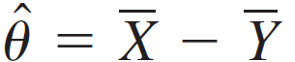



z Tests and Confidence Intervals for a Difference Between Two Population Means
If we regard μ₁ – μ₂ as a parameter θ, then its estimator is with standard deviation given by the proposition. When and both have known values, the value of this standard deviation can be calculated.
The sample variances must be used to estimate when and are unknown.

Slide 12
Test Procedures for Normal Populations with Known Variances

Slide 13


Test Procedures for Normal Populations with Known Variances
We know that, the first CI and test procedure for a population mean μ were based on the assumption that the population distribution was normal with the value of the population variance known to the investigator.
Similarly, we first assume here that both population distributions are normal and that the values of both and are known. Situations in which one or both of these assumptions can be dispensed with will be presented shortly.

Slide 14

Test Procedures for Normal Populations with Known Variances
Because the population distributions are normal, both and have normal distributions.
Furthermore, independence of the two samples implies that the two sample means are independent of one another.
Thus the difference is normally distributed, with expected value μ₁ – μ₂ and standard deviation given in the foregoing proposition.

Slide 15

Test Procedures for Normal Populations with Known Variances
Standardizing gives the standard normal variable
In a hypothesis-testing problem, the null hypothesis will state that μ₁ – μ₂ has a specified value.
(9.1)

Slide 16
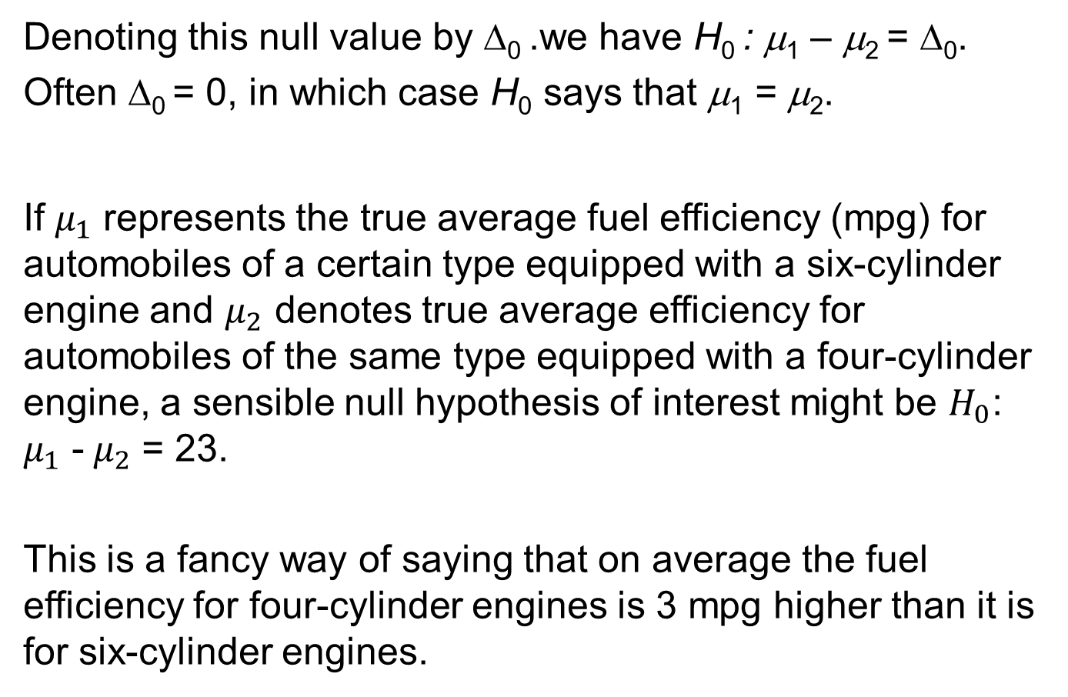
Test Procedures for Normal Populations with Known Variances
Denoting this null value by Δ₀ .we have H₀ : μ₁ – μ₂ = Δ₀. Often Δ₀ = 0, in which case H₀ says that μ₁ = μ₂.
If $μ_{1}$ represents the true average fuel efficiency (mpg) for automobiles of a certain type equipped with a six-cylinder engine and $μ_{2}$ denotes true average efficiency for automobiles of the same type equipped with a four-cylinder engine, a sensible null hypothesis of interest might be $H_{0}$: $μ_{1}$ -${ μ}_{2}$ = 23.
This is a fancy way of saying that on average the fuel efficiency for four-cylinder engines is 3 mpg higher than it is for six-cylinder engines.

Slide 17

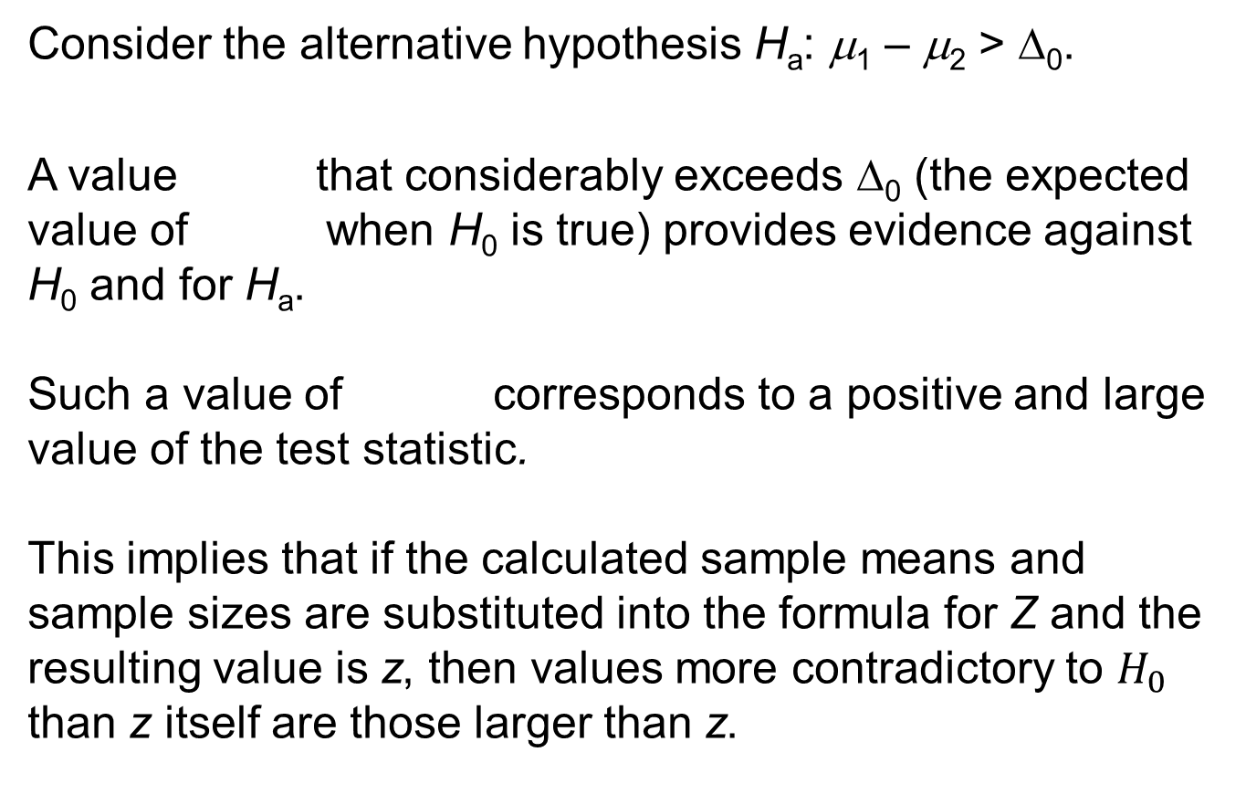
Test Procedures for Normal Populations with Known Variances
Consider the alternative hypothesis H_{a}: μ₁ – μ₂ > Δ₀.
A value that considerably exceeds Δ₀ (the expected value of when H₀ is true) provides evidence against H₀ and for H_{a}.
Such a value of corresponds to a positive and large value of the test statistic.
This implies that if the calculated sample means and sample sizes are substituted into the formula for Z and the resulting value is z, then values more contradictory to $H_{0}$ than z itself are those larger than z.

Slide 18
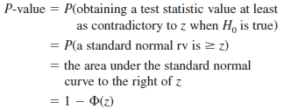
Test Procedures for Normal Populations with Known Variances
Thus
The test procedure in this case is upper-tailed because the P-value is an upper-tail z curve area.

Slide 19
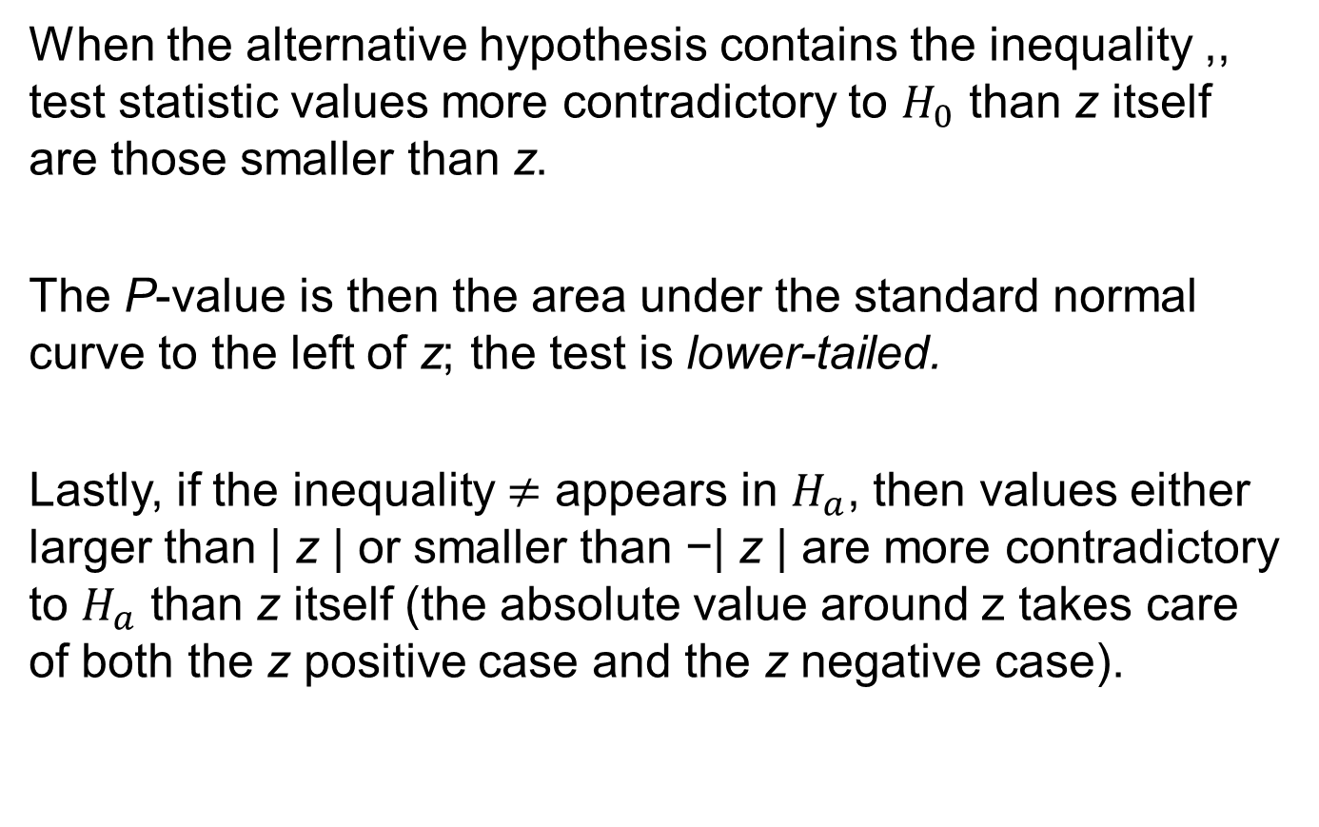
Test Procedures for Normal Populations with Known Variances
When the alternative hypothesis contains the inequality ,, test statistic values more contradictory to $H_{0}$ than z itself are those smaller than z.
The P-value is then the area under the standard normal curve to the left of z; the test is lower-tailed.
Lastly, if the inequality $≠$ appears in $H_{a}$, then values either larger than | z | or smaller than −| z | are more contradictory to $H_{a}$ than z itself (the absolute value around z takes care of both the z positive case and the z negative case).

Slide 20
Test Procedures for Normal Populations with Known Variances
The implication is that the P-value is the sum of the area under the standard normal curve to the left of 2| z | and the area to the right of | z |—that is, a two-tailed test. This sum of two tail areas is the same as doubling the captured tail area.

Slide 21
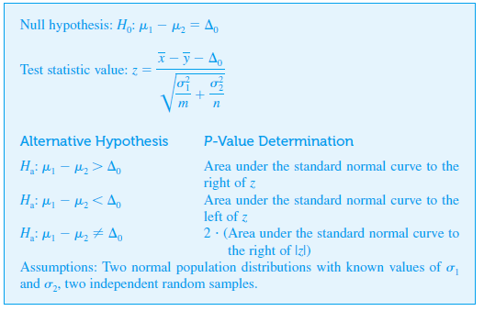
Test Procedures for Normal Populations with Known Variances

Slide 22
Example 9.1
Analysis of a random sample consisting of m = 20 specimens of cold-rolled steel to determine yield strengths resulted in a sample average strength of
A second random sample of n = 25 two-sided galvanized steel specimens gave a sample average strength of

Slide 23
Example 9.1
cont’d
Assuming that the two yield-strength distributions are normal with σ₁ = 4.0 and σ₂ = 5.0 (suggested by a graph in the article “Zinc-Coated Sheet Steel: An Overview,” Automotive Engr., Dec. 1984: 39–43), does the data indicate that the corresponding true average yield strengths μ₁ and μ₂ are different? Let’s carry out a test at significance level α = 0.1.

Slide 24
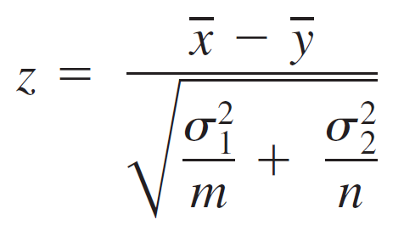
Example 9.1
cont’d
1. The parameter of interest is μ₁ – μ_{2,} the difference between the true average strengths for the two types of steel.
2. The null hypothesis is H₀ : μ₁ – μ₂ = 0
3. The alternative hypothesis is H_{a} : μ₁ – μ₂ ≠ 0
if H_{a} is true, then μ₁ and μ₂ are different.
4. With Δ₀ = 0,the test statistic value is

Slide 25

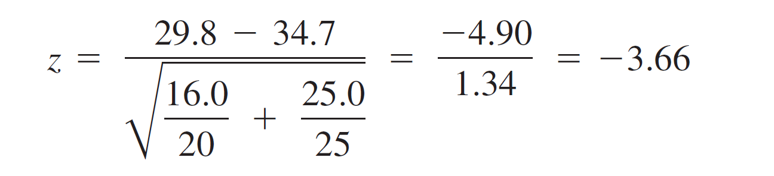
Example 9.1
cont’d
5. Substituting m = 20, = 29.8, = 16.0, n = 25, = 34.7
and = 25.0 into the formula for z yields
That is, the observed value of is more than 3 standard deviations below what would be expected were H₀ true.

Slide 26

Example 9.1
6. The $≠$ inequality in $H_{a}$ implies that a two-tailed test is appropriate. The P-value is

Slide 27

Example 9.1
cont’d
7. Since P-value $≈0≤.01=α, H_{a}$is therefore rejected at level .01 in favor of the conclusion that${ μ}_{1}≠μ_{2}$. In fact, with a P-value this small, the null hypothesis would be rejected at any sensible significance level. The sample data strongly suggests that the true average yield strength for cold-rolled steel differs from that for galvanized steel.

Slide 28
Using a Comparison to Identify Causality

Slide 29
Using a Comparison to Identify Causality
Investigators are often interested in comparing either the effects of two different treatments on a response or the response after treatment with the response after no treatment (treatment vs. control).
If the individuals or objects to be used in the comparison are not assigned by the investigators to the two different conditions, the study is said to be observational.

Slide 30
Using a Comparison to Identify Causality
The difficulty with drawing conclusions based on an observational study is that although statistical analysis may indicate a significant difference in response between the two groups.
The difference may be due to some underlying factors that had not been controlled rather than to any difference in treatments.

Slide 31
Example 9.2
A letter in the Journal of the American Medical Association (May 19, 1978) reported that of 215 male physicians who were Harvard graduates and died between November 1974 and October 1977.
The 125 in full-time practice lived an average of 48.9 years beyond graduation, whereas the 90 with academic affiliations lived an average of 43.2 years beyond graduation.

Slide 32
Example 9.2
cont’d
Does the data suggest that the mean lifetime after graduation for doctors in full-time practice exceeds the mean lifetime for those who have an academic affiliation?
(If so, those medical students who say that they are “dying to obtain an academic affiliation” may be closer to the truth than they realize; in other words, is “publish or perish” really “publish and perish”?)

Slide 33
Example 9.2
cont’d
Let μ₁ denote the true average number of years lived beyond graduation for physicians in full-time practice, and let μ₂ denote the same quantity for physicians with academic affiliations.
Assume the 125 and 90 physicians to be random samples from populations 1 and 2, respectively (which may not be reasonable if there is reason to believe that Harvard graduates have special characteristics that differentiate them from all other physicians—in this case inferences would be restricted just to the “Harvard populations”).

Slide 34
Example 9.2
cont’d
The letter from which the data was taken gave no information about variances.
So for illustration assume that σ₁ = 14.6 and σ₂ = 14.4.
The hypotheses are H₀ = μ₁ – μ₂ = 0 versus
H_{a} = μ₁ – μ₂ > 0, so Δ₀ is zero.

Slide 35
Example 9.2
cont’d
The computed value of the test statistic is

Slide 36
Example 9.2
cont’d
The P-value for an upper-tailed test is 1 – Φ(2.85) = .0022. At significance level .01, H₀ is rejected (because α > P-value) in favor of the conclusion that
μ₁ – μ₂ > 0 (μ₁ > μ₂).
This is consistent with the information reported in the letter.

Slide 37
Example 9.2
cont’d
This data resulted from a retrospective observational study; the investigator did not start out by selecting a sample of doctors and assigning some to the “academic affiliation” treatment and the others to the “full-time practice” treatment, but instead identified members of the two groups by looking backward in time (through obituaries!) to past records.

Slide 38
Example 9.2
cont’d
Can the statistically significant result here really be attributed to a difference in the type of medical practice after graduation, or is there some other underlying factor (e.g., age at graduation, exercise regimens, etc.) that might also furnish a plausible explanation for the difference?
Observational studies have been used to argue for a causal link between smoking and lung cancer.

Slide 39
Example 9.2
cont’d
There are many studies that show that the incidence of lung cancer is significantly higher among smokers than among nonsmokers.
However, individuals had decided whether to become smokers long before investigators arrived on the scene, and factors in making this decision may have played a causal role in the contraction of lung cancer.

Slide 40
Using a Comparison to Identify Causality
A randomized controlled experiment results when investigators assign subjects to the two treatments in a random fashion.
When statistical significance is observed in such an experiment, the investigator and other interested parties will have more confidence in the conclusion that the difference in response has been caused by a difference in treatments.

Slide 41
β and the Choice of Sample Size

Slide 42
β and the Choice of Sample Size
The probability of a type II error is easily calculated when both population distributions are normal with known values of σ₁ and σ₂.
Consider the case in which the alternative hypothesis is
H_{a}: μ₁ – μ₂ > Δ₀.
Let Δ′, denote a value of μ₁ – μ₂ that exceeds Δ₀.
(a value for which H₀ is false).

Slide 43

β and the Choice of Sample Size
The upper-tailed rejection region can be re expressed in the form
Thus
β (Δ′) = P (Not rejecting H₀ when μ₁ – μ₂ = Δ′)
When μ₁ – μ₂ = Δ′ , is normally distributed with mean value Δ′ and standard deviation (the same standard deviation as when H₀ is true); using these values to standardize the inequality in parentheses gives the desired probability.

Slide 44
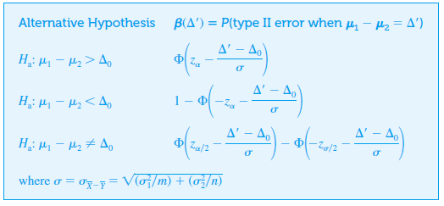
β and the Choice of Sample Size

Slide 45
Example 9.3
Suppose that when μ₁ and μ₂ (the true average yield strengths for the two types of steel) differ by as much as 5, the probability of detecting such a departure from H₀ (the power of the test) should be .90. Does a level .01 test with sample sizes m = 20 and n = 25 satisfy this condition?
The value of σ for these sample sizes (the denominator of z) was previously calculated as 1.34.

Slide 46
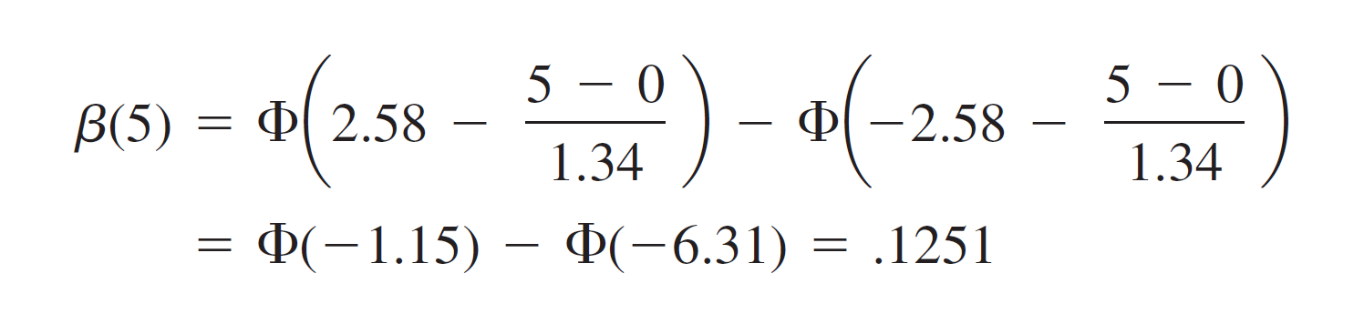
Example 9.3
cont’d
The probability of a type II error for the two-tailed level .01 test when μ₁ – μ₂ = Δ′ = 5 is

Slide 47
Example 9.3
cont’d
It is easy to verify that β (–5) = .1251 also (because the rejection region is symmetric).
Thus the power is 1 – β (5) = .8749.
Because this is somewhat less than .9, slightly larger sample sizes should be used.

Slide 48
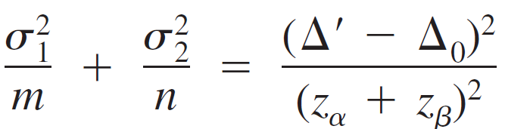
β and the Choice of Sample Size
Sample sizes m and n can be determined that will satisfy both P (type I error) = a specified α and P (type II error when μ₁ – μ₂ = Δ′) = a specified β.
For an upper-tailed test, equating the previous expression for β(Δ′) to the specified value of β gives

Slide 49
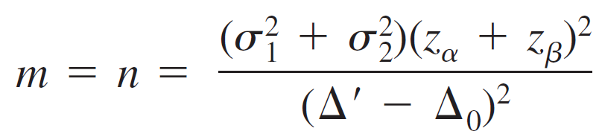
β and the Choice of Sample Size
When the two sample sizes are equal, this equation yields
These expressions are also correct for α lower-tailed test, whereas α is replaced by α/2 for a two-tailed test.

Slide 50
Large-Sample Tests

Slide 51



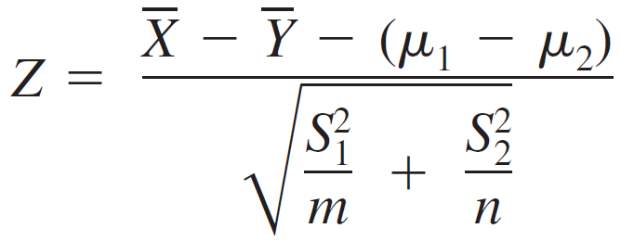
Large-Sample Tests
The assumptions of normal population distributions and known values of σ₁ and σ₂ are fortunately unnecessary when both sample sizes are sufficiently large. In this case, the Central Limit Theorem guarantees that has approximately a normal distribution regardless of the underlying population distributions.
Furthermore, using and in place of and in Expression (9.1) gives a variable whose distribution is approximately standard normal:

Slide 52
Large-Sample Tests
A large-sample test statistic results from replacing μ₁ – μ₂ by Δ₀, the expected value of when H₀ is true. This statistic Z then has approximately a standard normal distribution when H₀ is true, which allows for straightforward determination of a P-value as a z curve area.

Slide 53
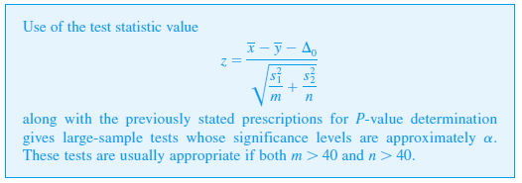
Large-Sample Tests

Slide 54
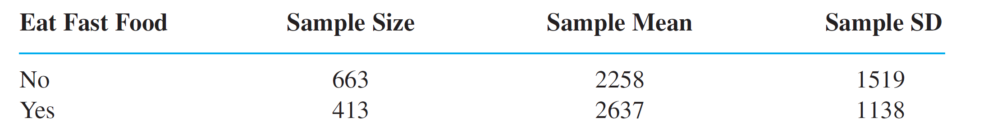
Example 9.4
What impact does fast-food consumption have on various dietary and health characteristics?
The article “Effects of Fast-Food Consumption on Energy Intake and Diet Quality Among Children in a National Household Study” (Pediatrics, 2004:112–118) reported the accompanying summary data on daily calorie intake both for a sample of teens who said they did not typically eat fast food and another sample of teens who said they did usually eat fast food.

Slide 55
Example 9.4
cont’d
Does this data provide strong evidence for concluding that true average calorie intake for teens who typically eat fast food exceeds by more than 200 calories per day the
true average intake for those who don’t typically eat fast food?
Let’s investigate by carrying out a test of hypotheses at a significance level of approximately .05.

Slide 56
Example 9.4
cont’d
The parameter of interest is μ₁ – μ₂, where μ₁ is the true average calorie intake for teens who don’t typically eat fast food and μ₂ is true average intake for teens who do typically eat fast food.
The hypotheses of interest are
H₀ : μ₁ – μ₂ = –200 versus H_{a} : μ₁ – μ₂ < –200
The alternative hypothesis asserts that true average daily intake for those who typically eat fast food exceeds that for those who don’t by more than 200 calories.

Slide 57
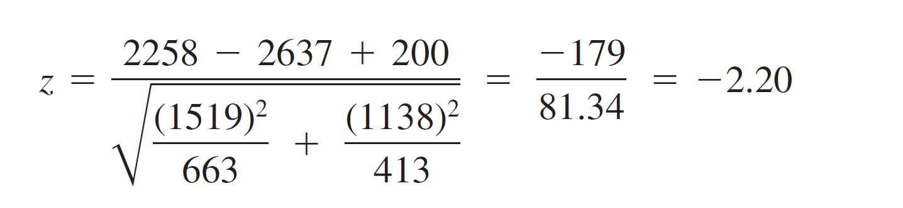
Example 9.4
cont’d
The test statistic value is
The inequality in H_{a} implies that the test is lower-tailed; H₀ should be rejected if z ≤ –z_{0.5} = –1.645.
The calculated test statistic value is

Slide 58
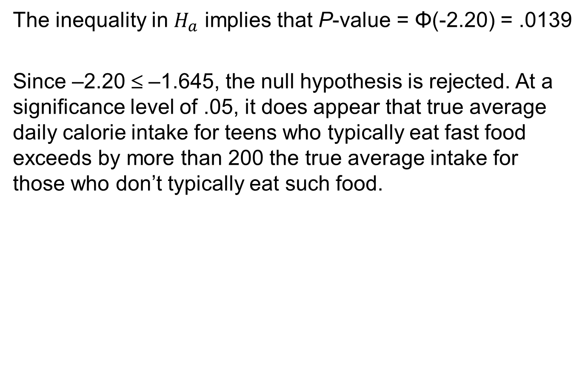
Example 9.4
cont’d
The inequality in $H_{a}$ implies that P-value = Φ(-2.20) = .0139
Since –2.20 ≤ –1.645, the null hypothesis is rejected. At a significance level of .05, it does appear that true average daily calorie intake for teens who typically eat fast food exceeds by more than 200 the true average intake for those who don’t typically eat such food.

Slide 59
Example 9.4
cont’d
However, the P-value is not small enough to justify rejecting H₀ at significance level .01.
Notice that if the label 1 had instead been used for the fast-food condition and 2 had been used for the no-fast-food condition, then 200 would have replaced –200 in both hypotheses and H_{a} would have contained the inequality >, implying an upper-tailed test. The resulting test statistic value would have been 2.20, giving the same P-value as before.

Slide 60
Confidence Intervals for μ₁ – μ₂

Slide 61
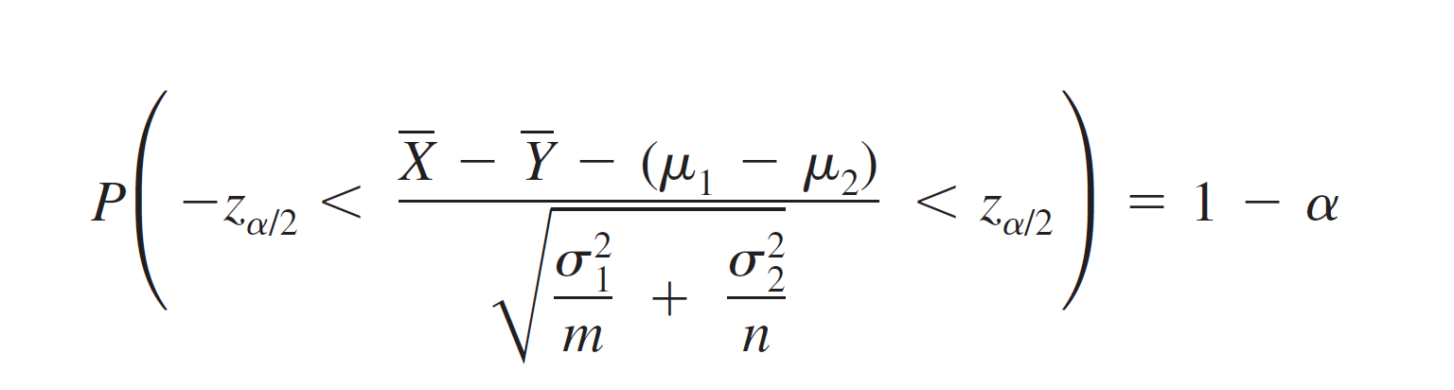
Confidence Intervals for μ₁ – μ₂
When both population distributions are normal, standardizing gives a random variable Z with a standard normal distribution.
Since the area under the z curve between – z_{α/2} and z_{α/2} is 1 – α, it follows that

Slide 62
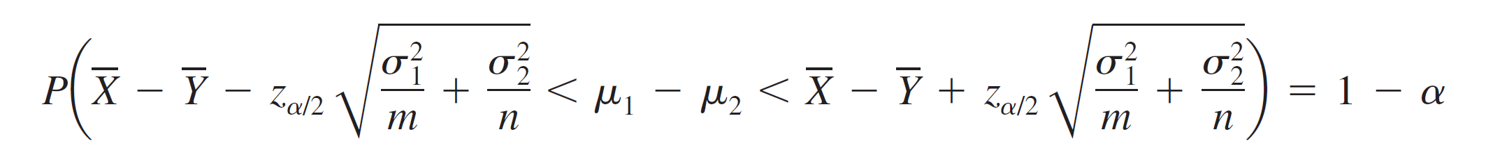




Confidence Intervals for μ₁ – μ₂
Manipulation of the inequalities inside the parentheses to isolate μ₁ – μ₂ yields the equivalent probability statement
This implies that a 100(1 – α)% CI for μ₁ – μ₂ has lower limit and upper limit where is the square-root expression. This interval is a special case of the general formula

Slide 63


Confidence Intervals for μ₁ – μ₂
If both m and n are large, the CLT implies that this interval is valid even without the assumption of normal populations; in this case, the confidence level is approximately 100(1 – α)%.
Furthermore, use of the sample variances and in the standardized variable Z yields a valid interval in which and replace and

Slide 64
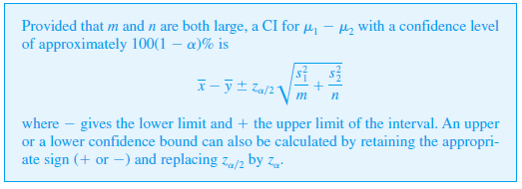
Confidence Intervals for μ₁ – μ₂
Our standard rule of thumb for characterizing sample sizes as large is m > 40 and n > 40.

Slide 65
Example 9.5
Enhanced heavy oil recovery uses steam delivered to the production zone. The annulus between rock formation and the metal casing pipe is filled with cement.
The article “Thermal Stability of the Cement Sheath in Steam Treated Oil Wells” (J. of the Amer. Ceramic Soc., 2011: 4463–4470) reported on a study of cement sheath performance when various thermal cements were cured at 35 °C and then heated to 230 °C.
Here is summary data on Vicker’s hardness (MPa) for both a control cement and an experimental cement:

Slide 66

Example 9.5
Here is summary data on Vicker’s hardness (MPa) for both a control cement and an experimental cement:
Figure 9.1 shows a comparative boxplot of data consistent with these summary quantities. The main difference between the two samples appears to be where they are centered.

Slide 67
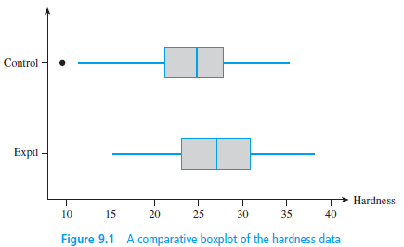
Example 9.5
cont’d
Figure 9.1 shows a comparative boxplot of data consistent with these summary quantities. The main difference between the two samples appears to be where they are centered.

Slide 68


Example 9.5
cont’d
Let’s now calculate a confidence interval for the difference between true average hardness for the control cement ($μ_{1}$) and true average hardness for the experimental cement ($μ_{2}$) using a confidence level of 95%:
That is, with 95% confidence, $−4.9<μ_{1}−μ_{2}<−5$.

Slide 69
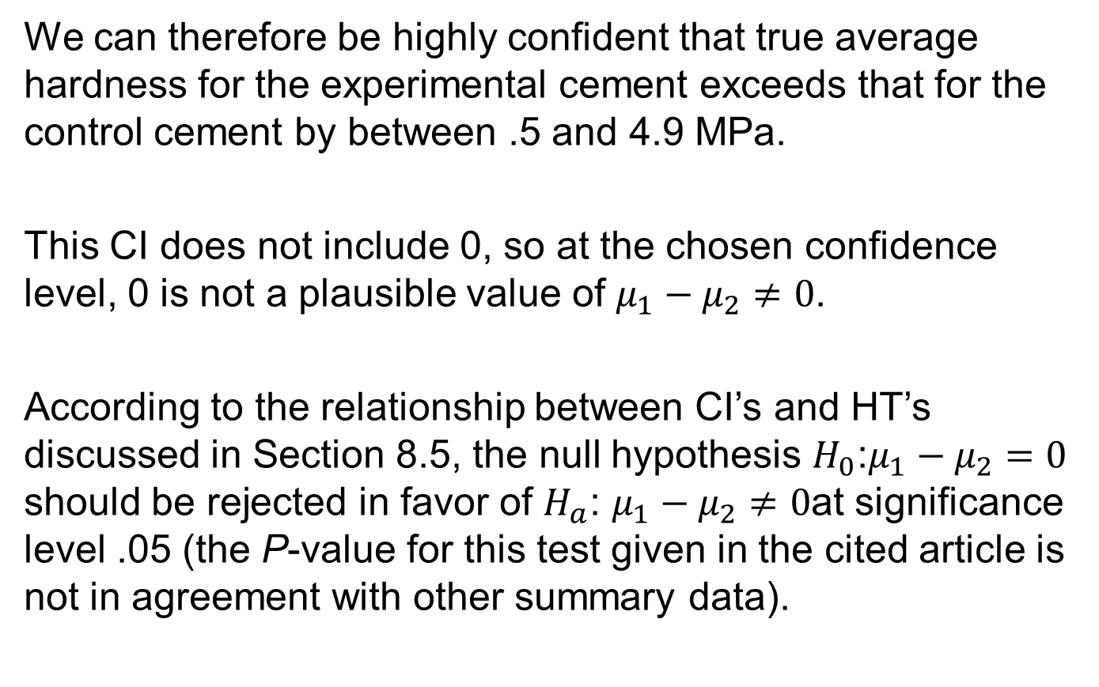
Example 9.5
We can therefore be highly confident that true average hardness for the experimental cement exceeds that for the control cement by between .5 and 4.9 MPa.
This CI does not include 0, so at the chosen confidence level, 0 is not a plausible value of $μ_{1}−μ_{2}≠0$.
According to the relationship between CI’s and HT’s discussed in Section 8.5, the null hypothesis $H_{0}$:$μ_{1}−μ_{2}=0$ should be rejected in favor of $H_{a}$: $μ_{1}−μ_{2}≠0$at significance level .05 (the P-value for this test given in the cited article is not in agreement with other summary data).

Slide 70

Example 9.5
Notice that if we relabel so that $μ_{1}$ refers to the experimental cement and $μ_{2}$ to the control cement, the CI becomes (.5, 4.9). The interpretation of the interval is
exactly the same as was that of the first interval.

Slide 71
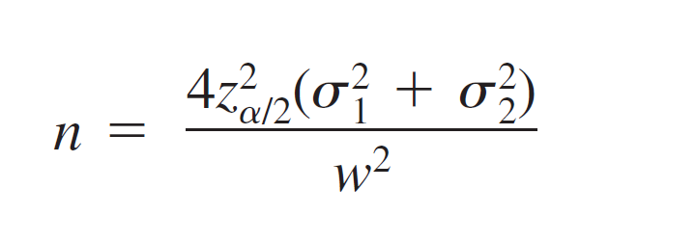
Confidence Intervals for μ₁ – μ₂
If the variances and are at least approximately known and the investigator uses equal sample sizes, then the common sample size n that yields a 100(1 – α )% interval of width w is
which will generally have to be rounded up to an integer.

